Slide 1


Data Structures & Algorithms for Interviews
Vignesh Narayanan

Slide 2
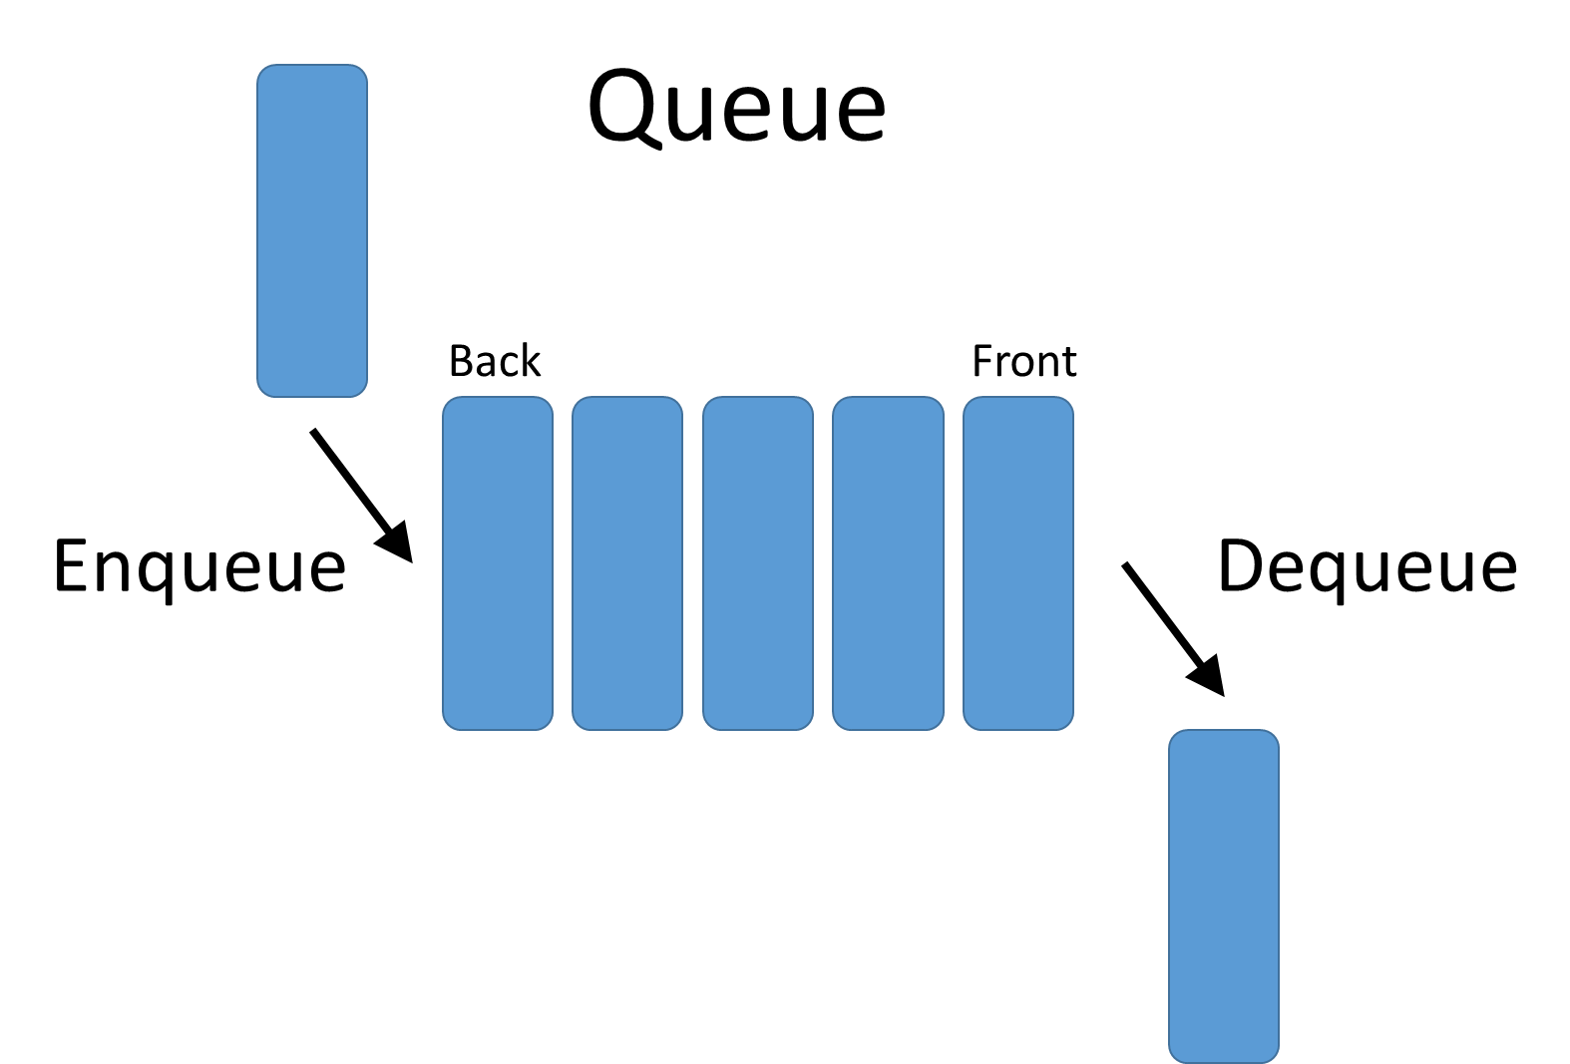
Queues

Slide 3
Implement Queue using Stacks
We are given a Stack data structure that supports standard operations like push() and pop(). We need to implement a Queue data structure using only instances of Queue.

Slide 4
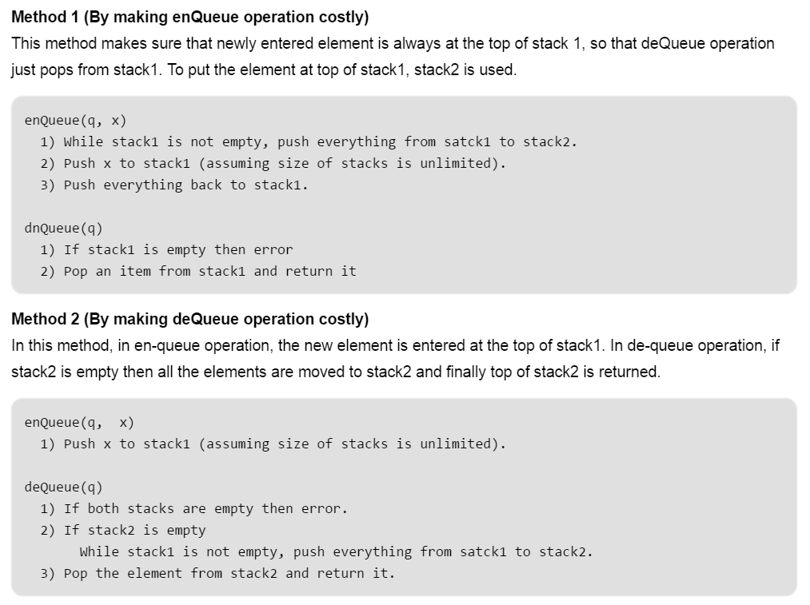

Slide 5
Maximum of all sub arrays of size k (Added a O(n) method)
Given an array and an integer k, find the maximum for each and every contiguous subarray of size k.
Example:
Input : arr[] = {1, 2, 3, 1, 4, 5, 2, 3, 6} k = 3 Output : 3 3 4 5 5 5 6

Slide 6
